Slide 1

Introduction to Python - Part 4
Container Objects - String and List

Slide 2
Python collection objects
Collection objects are objects that can hold any number of arbitrary elements
Collections or container objects provides a way to access elements and iterate over them
Some collection objects:
String
List
Tuple
Dictionary
Set

Slide 3
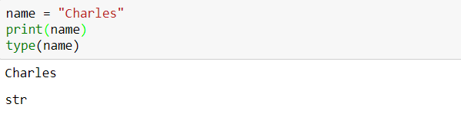
Creating string variables
String variables are variables that hold zero or more characters such as letters, numbers, spaces, commas and many more
Use type(variable_name) to check the data type of variable declared

Slide 4
Indexing and slicing
Indexing is a process of referring an element of an iterable (string, list, tuple, etc) by its position, called index, within the iterable
Slicing is a process of getting a subset of elements from an iterable based on their indices
To retrieve an element of the list, we use the index operator []. Iterables are “zero indexed”, so [0] returns the zero-th (i.e. the left-most) item in the list, and [1] returns the one-th item
Python also allows you to index from the end of the list using a negative number

Slide 5
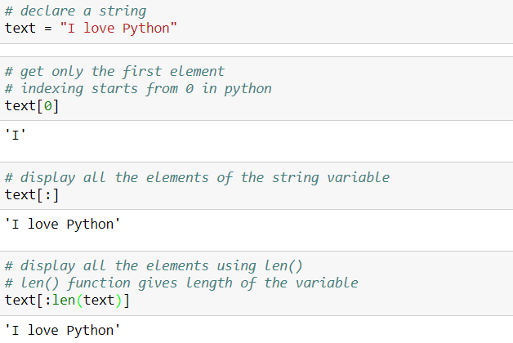
Indexing and slicing
Example:
‘:’ is used to specify range of the sequence to be sliced

Slide 6
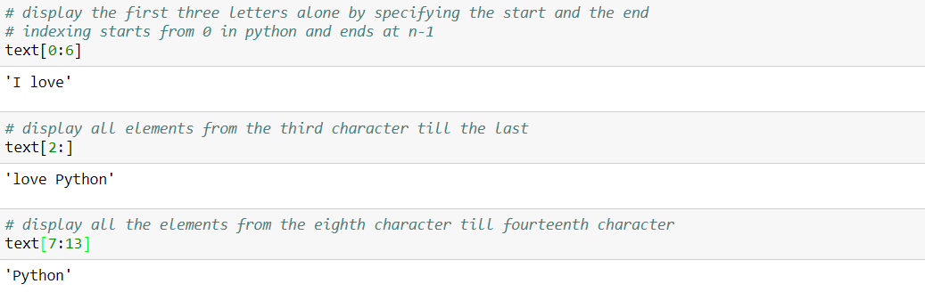
Indexing and slicing
Example:

Slide 7
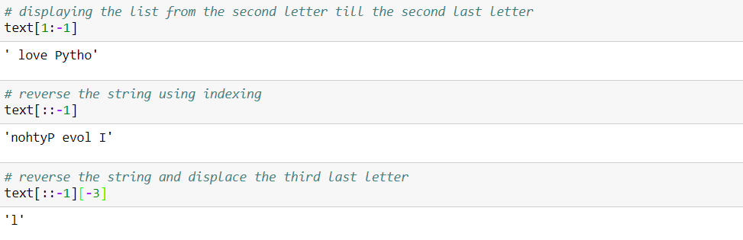
Indexing and slicing
Example:

Slide 8
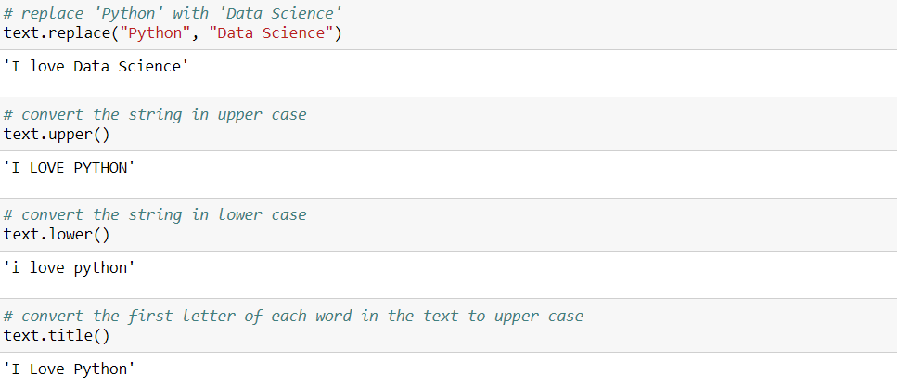
String Handling
Python has a set of built-in methods that you can use on strings
Some of the string built-in methods are as follows:

Slide 9
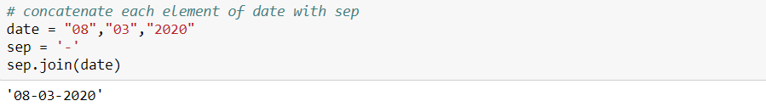
String Handling
Example:
Returns a concatenated string where each character of date is separated with sep string which is ‘-’

Slide 10
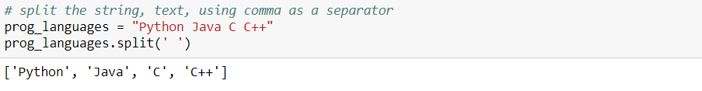
String Handling
Example:
Returns a list containing elements as strings separated by the space character

Slide 11
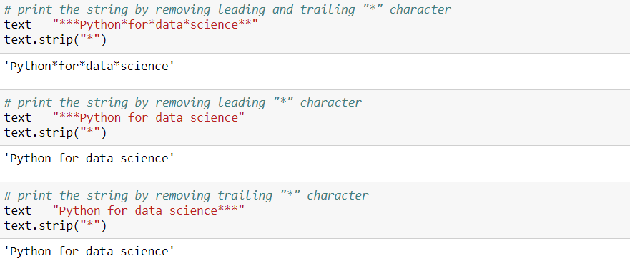
String Handling
Example:
Returns a copy of the string with both leading and trailing characters removed (based on the string argument passed)

Slide 12
List

Slide 13
List
Heterogeneous
Can have duplicates
Can be changed
Elements are separated by comma
Elements are enclosed in [ ] parenthesis

Slide 14
List
Supports the following:
Appending elements
Concatenation
Indexing and Slicing
min(), max(), len()
in, not in

Slide 15
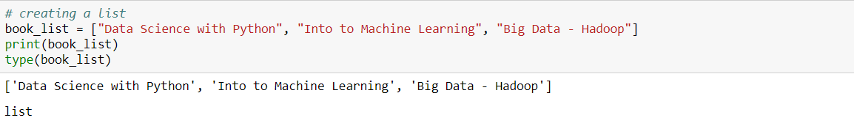
List Creation

Slide 16
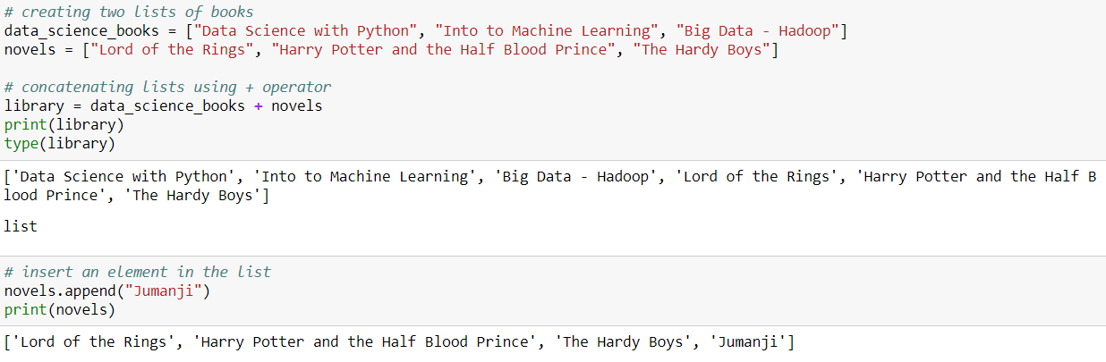
Concatenate and append

Slide 17
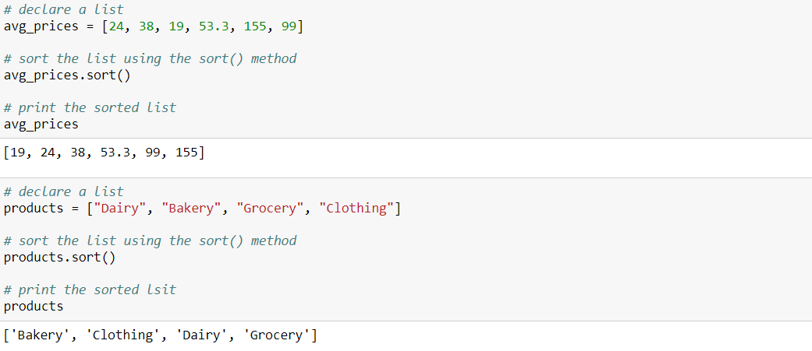
Sorting elements in the list

Slide 18

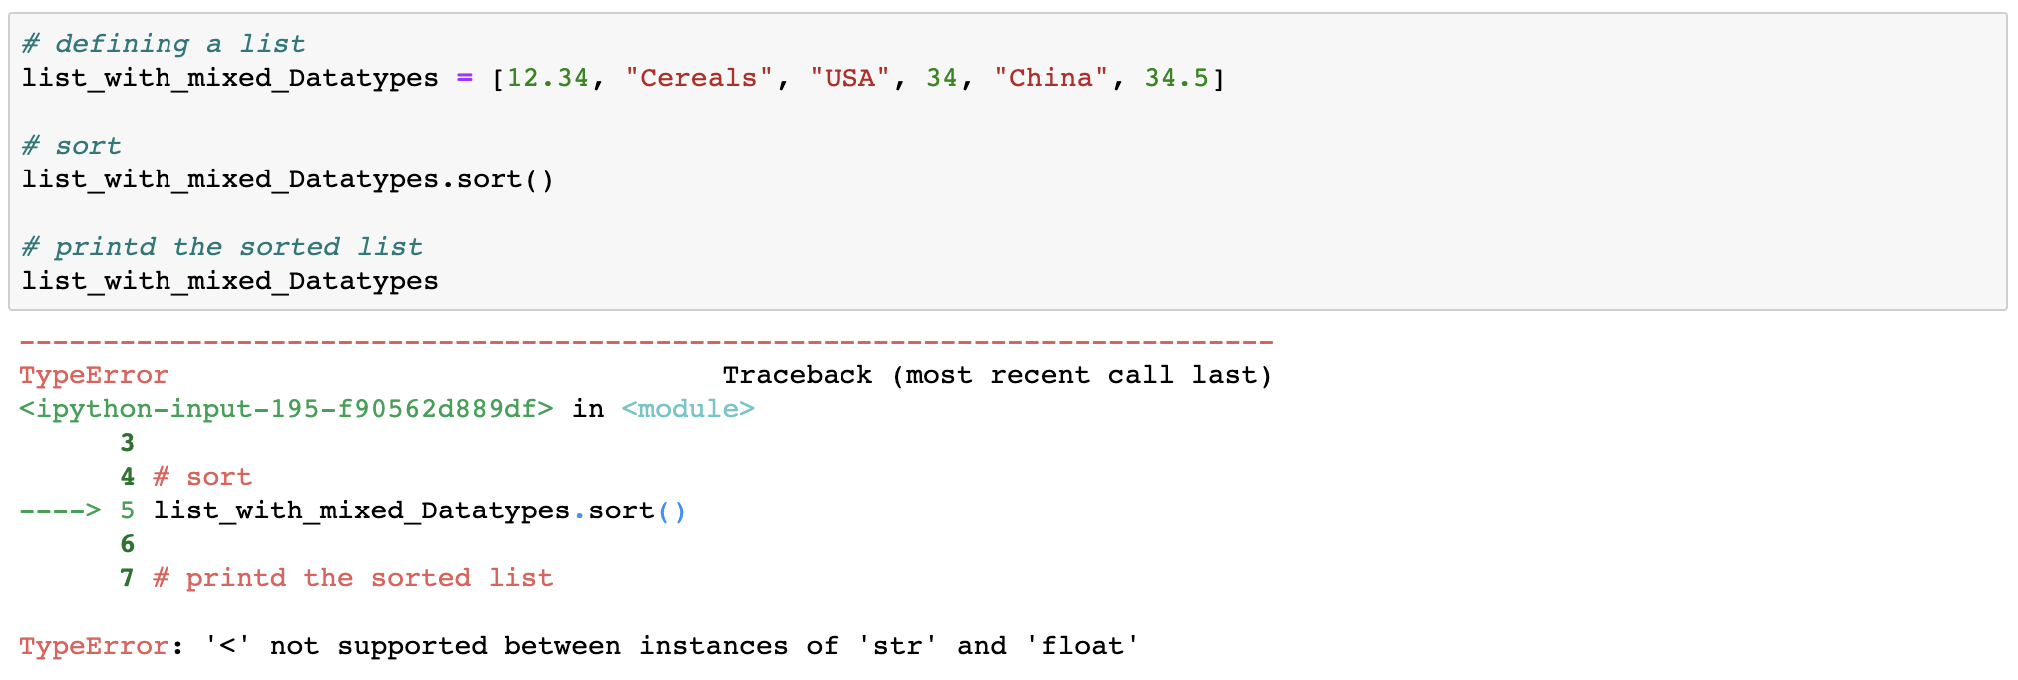
You cannot sort a list with mixed data types

Slide 19
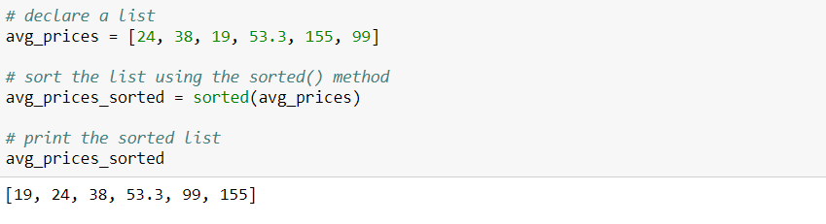
Sorting a list using the sorted() function

Slide 20
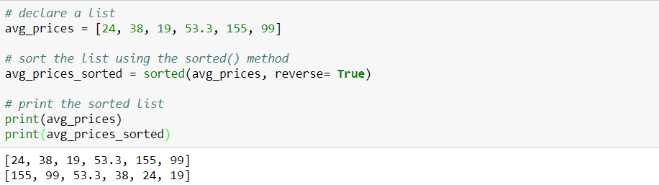
Sorting a list using the sorted() function
Passing the reverse=True parameter to the sorted() function sorts the list in reverse order by

Slide 21
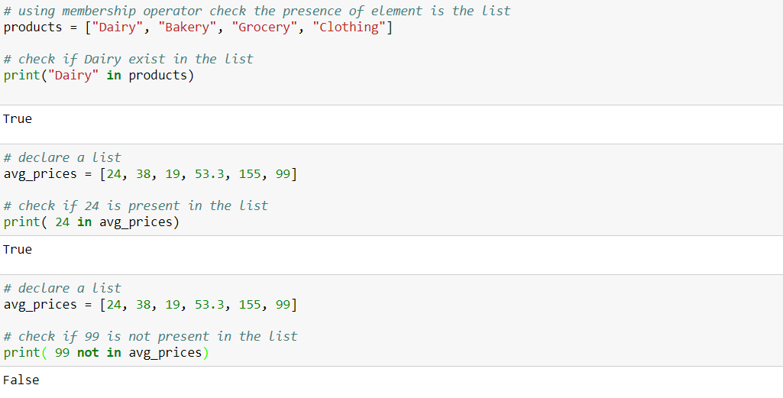
Checking presence of an element in the list

Slide 22
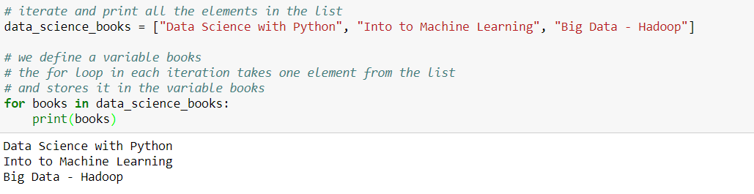
More list operations: iterating through a list
Iterating through all the elements in the list

Slide 23
More list operations
We learn more operations that can be performed on a list:
Finding the number of elements in a list
Finding the maximum & minimum value of a list with numeric values
Append a new element to a list
Remove all elements from a list
Create a copy of the list
Count the number of occurrences of a specified element
Return an index position of an object
Insert a new element to a list at a specified index position
Delete an element from a list
Reverse a list
Sort a list

Slide 24
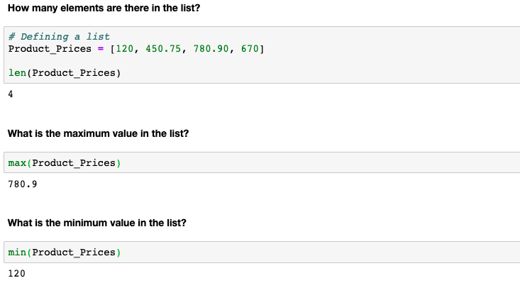
More list operations

Slide 25
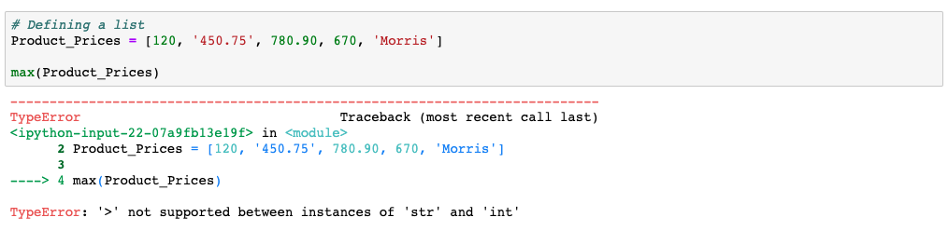
You cannot use max() & min() functions on a list with mixed data types

Slide 26
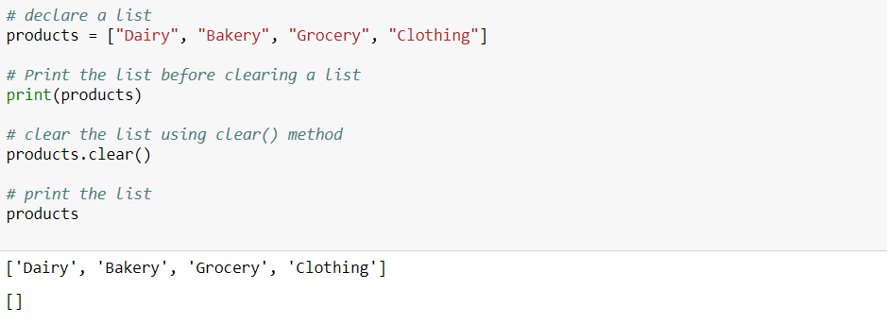
Removing all elements of a list
Note that though all elements are removed but the list still exists with no elements

Slide 27
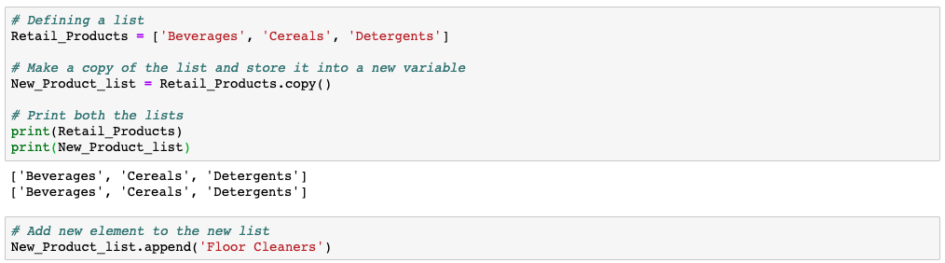
Making a shallow copy of an existing list
Note: A shallow copy is an actual copy of a list in a different variable

Slide 28
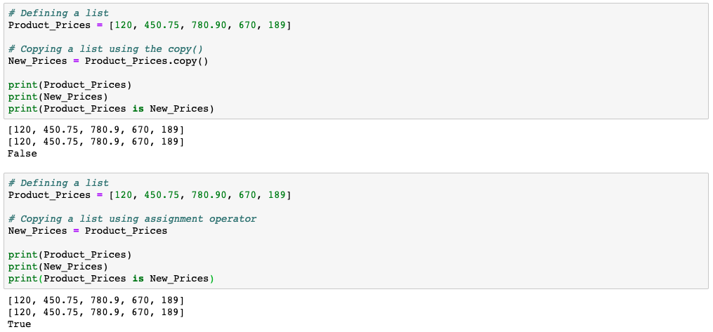
A shallow copy is the actual copy which gets created using the copy() function
copy() method is used to get a shallow copy. The two variables are different list objects.
We get a reference copy using the assignment operator. The two variables are referencing to the same list.

Slide 29
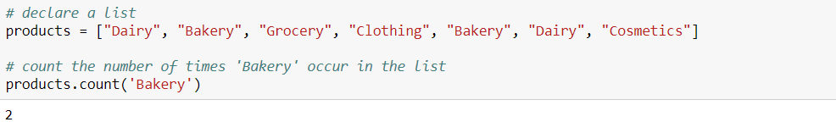
Counting number of occurrences of an element
Pass the element as an input parameter to the count() function that returns the count how many times ‘Bakery’ appear in the list

Slide 30
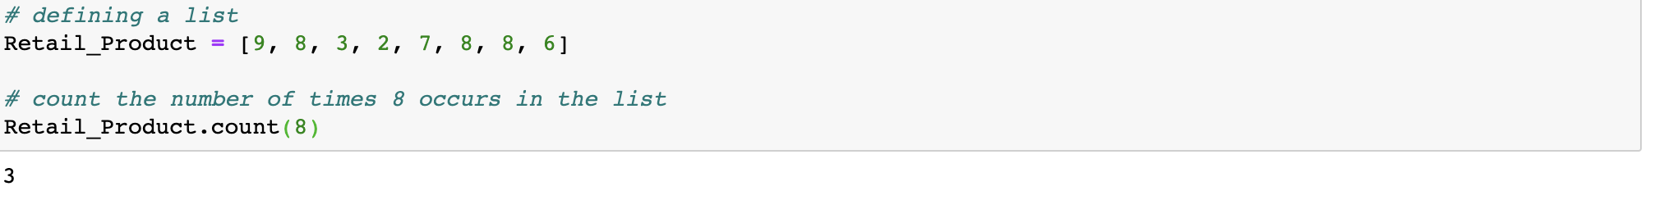
Count the number of occurrences of an element
The count() method works on numeric elements as well
Pass the element as an input parameter to the count() function and it will return the count of how many times 8 appear in the list

Slide 31
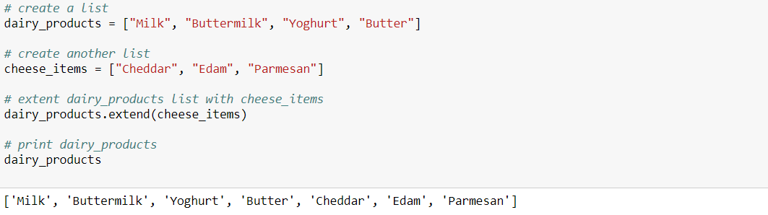
Extending a list
The extend() extends the current list by adding all items of the the specified list (passed as an argument) to an end

Slide 32
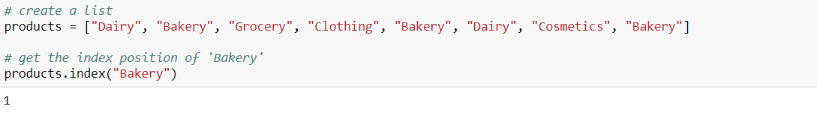
Returning the index position of an object
Note: This returns the lowest index position in case of multiple occurance

Slide 33
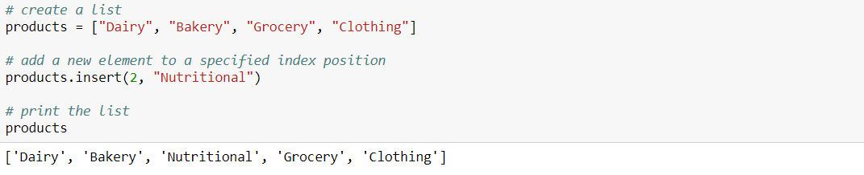
Insert a new element at a specified index position

Slide 34
Remove element from a list
There are two ways to remove the elements from the list:
Using pop() method, where the elements are removed by passing their index position
By using the remove() method, where the elements are removed by passing the element name

Slide 35
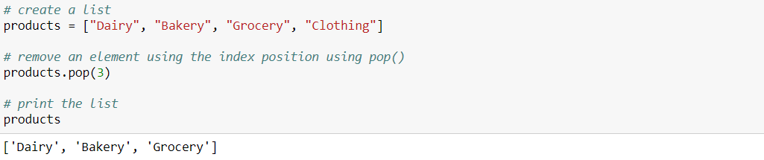
Remove element from a list
Using pop() method

Slide 36
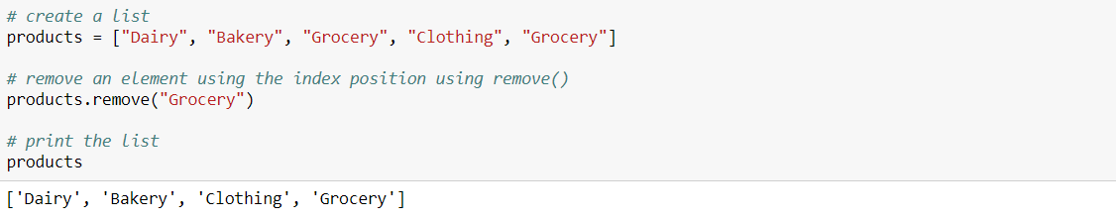
Remove element from a list
Using remove() method

Slide 37
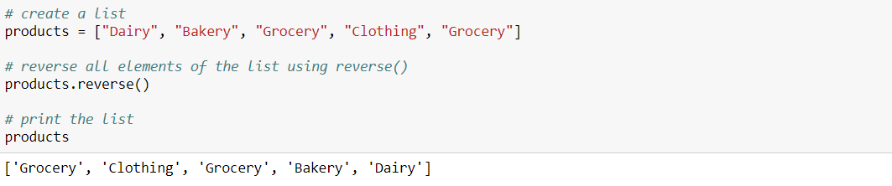
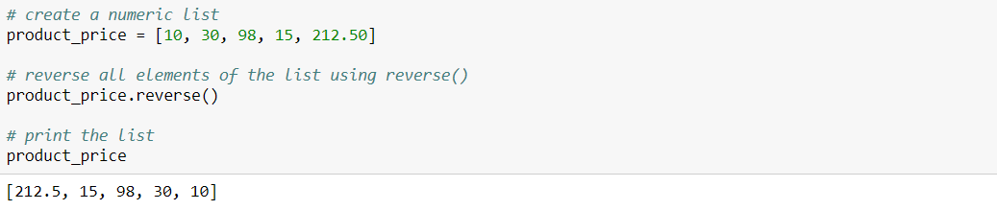
Reversing a list

Slide 38
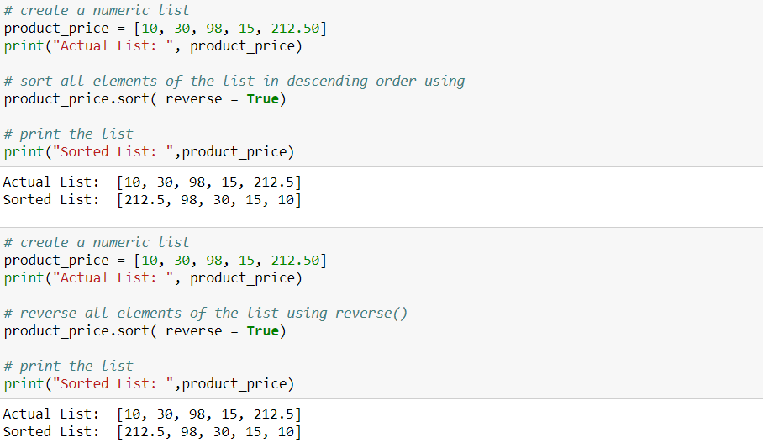
The list reverse() method and the parameter reverse in the sort() method are two different operations

Slide 39
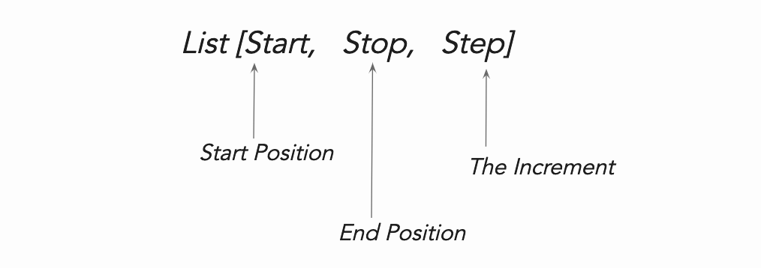
Indexing and Slicing lists

Slide 40
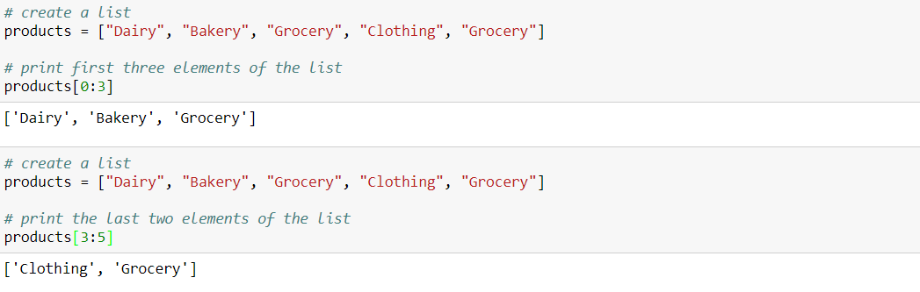
Slice a list: basic example

Slide 41
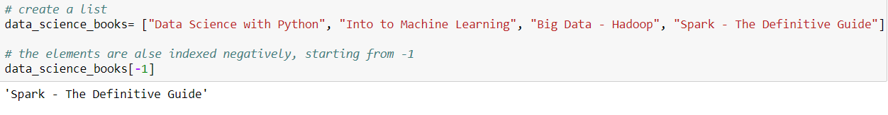
Slice a list using negative index
With negative index the elements are selected from right hand side of the list. The index of the right most element is -1

Slide 42
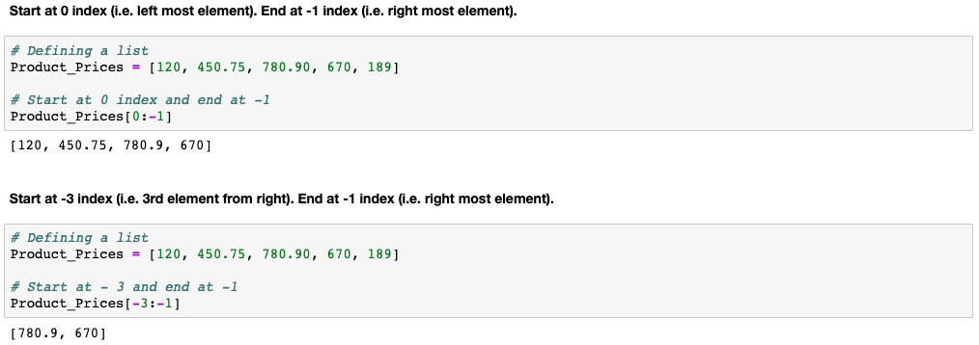
Slice a list using negative index

Slide 43
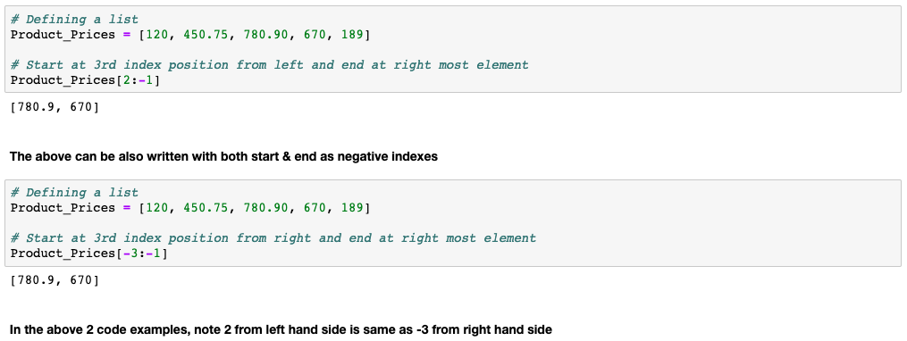
Slice a list using negative index

Slide 44
THANK YOU
Presenter’s Name
Contact Us
support@knowledgehut.com
Presenter’s Designation

